Slide 1
Apache Ignite as Kubernetes Store

Slide 2
Problem
No horizontal scalability: adding more etcd nodes does not improve latency
Native etcd “freezes” when there are 15K+ pods in Kubernetes cluster
Native etcd is highly available but not scalable
Only expensive vertical scalability is possible

Slide 3
Solution
Apache Ignite is horizontally scalable distributed database
Ignite-Etcd: shim layer converting Etcd API to Ignite API
Horizontal scaling solves the problem

Slide 4
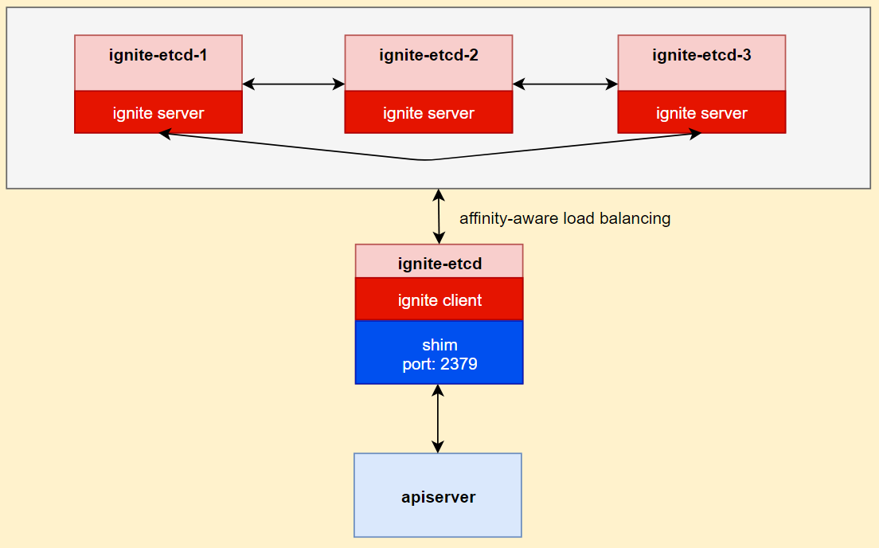
Architecture
ignite-etcd is a standalone POD
Shim layer converts Etcd to Ignite API
Ignite Client node communicates with Ignite cluster
Data and workload scale
Most efficient affinity-aware Ignite load balancing

Slide 5
Full Functional Compatibility
Etcd contract implemented
KV (range, put, delete, transaction)
Watch
Lease (grant, revoke, keep alive)
Health (check)
TODO
Cluster (list, add, remove nodes)
Authentication (list, add, remove users)
Maintenance (status, snapshots)
All Kubernetes integration tests PASS (see the report)

Slide 6
Security
Apiserver - Ignite-etcd connection secured with HTTPS
ignite-etcd --cert-file=ignite-etcd.crt --key-file=ignite-etcd.key
kube-apisever --etcd-cafile public.crt
Connections between Ignite nodes secured with SSL/TLS
Additional Transparent data encryption (TDE) is available in Ignite

Slide 7
Metrics
Full etcd metrics compatibility (see the metrics list)
HTTP /metrics endpoint provides metrics in Prometheus format

Slide 8
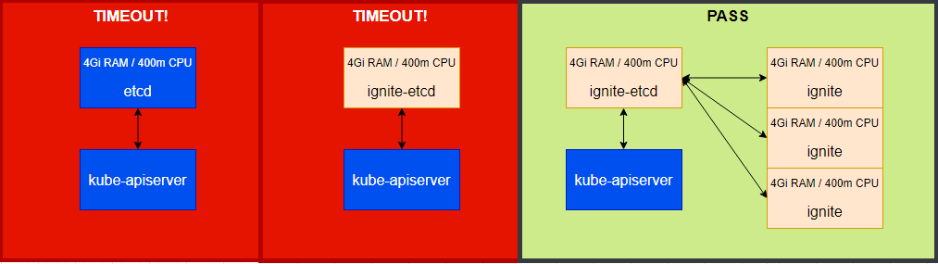
Proof-of-Concept: Horizontal Scalability
See report See report See report
Kubemark Density Tests
Native etcd limited with 4Gi/400m resources fails
3-nodes of the same size Ignite-etcd passes

Slide 9
Problems and Considerations
PUT not atomic
Ignite SQL is not transactional
Ignite-etcd uses K/V whenever possible. However, it is too much effort to get rid of SQL completely
Need to wait for Ignite 3 (2023), which will have transactional SQL (based on Calcite).
Real Performance & Throughput tests
TODO: Kubemark density and load tests with 15K pods PASS (see the report)

Slide 10
Development Resources
https://github.com/gridgain-solutions/ignite-in-k8s
Public ignite-etcd repo
Open issues
https://github.com/gridgain-solutions/kubernetes
Public Kubernetes repo forked from Kubernetes 1.19.6
Deployment scripts and resource definitions updated to replace native etcd with ignite-etcd
https://github.com/kubernetes/perf-tests
Public Kubernetes performance testing framework (kubemark) repo
No changes in the code.

Slide 11
Development Resources
https://github.com/etcd-io/etcd/tree/main/tools/benchmark
Benchmarking tool for etcd clusters
Another way to compare native etcd vs ignite-etc performance
The task is in progress:
The custom branch
Completed setup and benchmarking on a local machine. See the results.
TODO: run in a cluster

